Slide 1
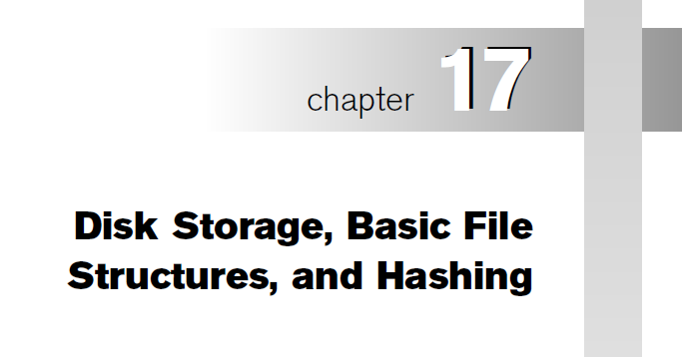

Slide 2
Chapter Outline
Physical database storage structure - @ physical level in 3-schema architecture
Disk Storage Devices
Files of Records
Operations on Files
Unordered Files
Ordered Files
Hashed Files
  Dynamic and Extendible Hashing Techniques
RAID Technology

Slide 3
Storage hierarchy
Primary storage –
  fast access to data but limited storage capacity
  Expensive
  Cache memory – static RAM
  Main memory - DRAM – volatile, decreasing cost
  Flash memory
Secondary & tertiary storage
  Magnetic disks, optical disks, tapes
  Hard disks – secondary
  Removable media – tertiary
  Larger capacity, cheaper, slower
  Data first copied into primary memory and then processed
Storage capacity – Kb, MB, GB, TB, PB

Slide 4
Storage of Databases
Database is persistent data
Most DBs stored in magnetic disks
  Too large to fit in main memory
  Non-volatile secondary storage prevents data loss
  Cost of storage per unit is less

Slide 5
Disk Storage Devices
Preferred secondary storage device for high storage capacity and low cost.
Data stored as magnetized areas on magnetic disk surfaces.
A disk pack contains several magnetic disks connected to a rotating spindle.
Disks are divided into concentric circular tracks on each disk surface (few hundreds to few thousands)
  Track capacities vary typically from 10s to 150 Kbytes
Slide 13- <number>

Slide 6
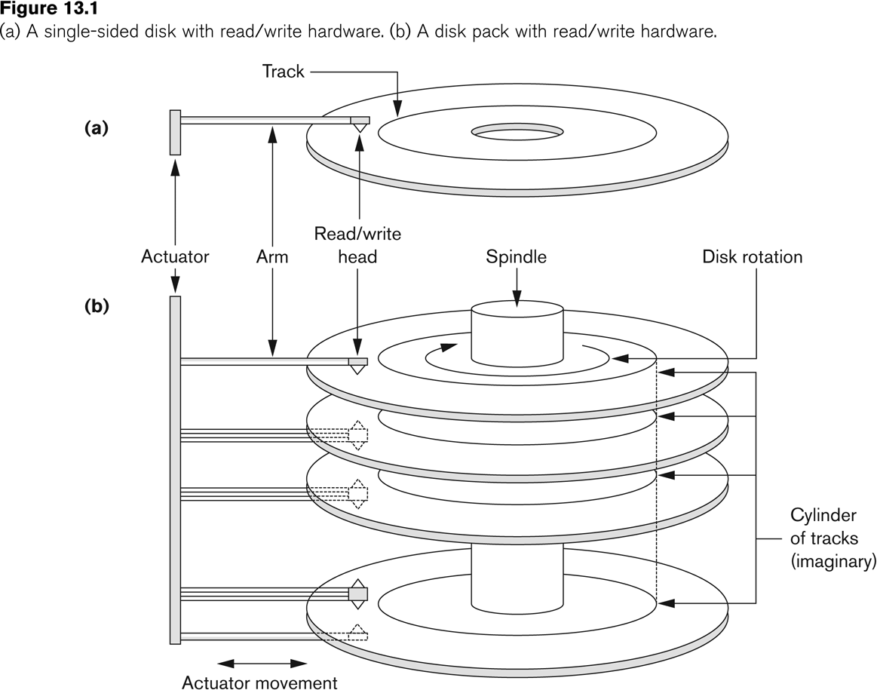
Disk Storage Devices (contd.)
Slide 13- <number>

Slide 7
Disk Storage Devices (contd.)
A track is divided into smaller blocks or sectors
  because it usually contains a large amount of information
The division of a track into sectors is hard-coded on the disk surface and cannot be changed.
  One type of sector organization calls a portion of a track that subtends a fixed angle at the center as a sector.
  Subtend smaller angles as you move away – uniform density
A track is divided into blocks.
  The block size B is fixed for each system.
    Typical block sizes range from B=512 bytes to 8192 bytes.
  Whole blocks are transferred between disk and main memory for processing.
Slide 13- <number>

Slide 8
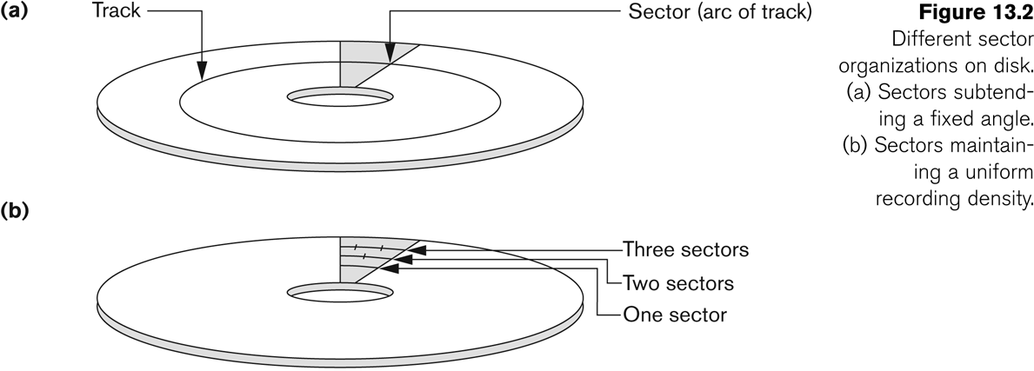
Disk Storage Devices (contd.)
Slide 13- <number>

Slide 9
Disk Storage Devices (contd.)
A read-write head moves to the track that contains the block to be transferred.
  Disk rotation moves the block under the read-write head for reading or writing.
A physical disk block (hardware) address consists of:
  a cylinder number (imaginary collection of tracks of same radius from all recorded surfaces)
  the track number or surface number (within the cylinder)
  and block number (within track).
Reading or writing a disk block is time consuming because of the seek time s and rotational delay (latency) rd. – s is 3 to 8 msecs, rd – 4 msecs
Bloc transfer time
Double buffering can be used to speed up the transfer of contiguous disk blocks.
Slide 13- <number>

Slide 10
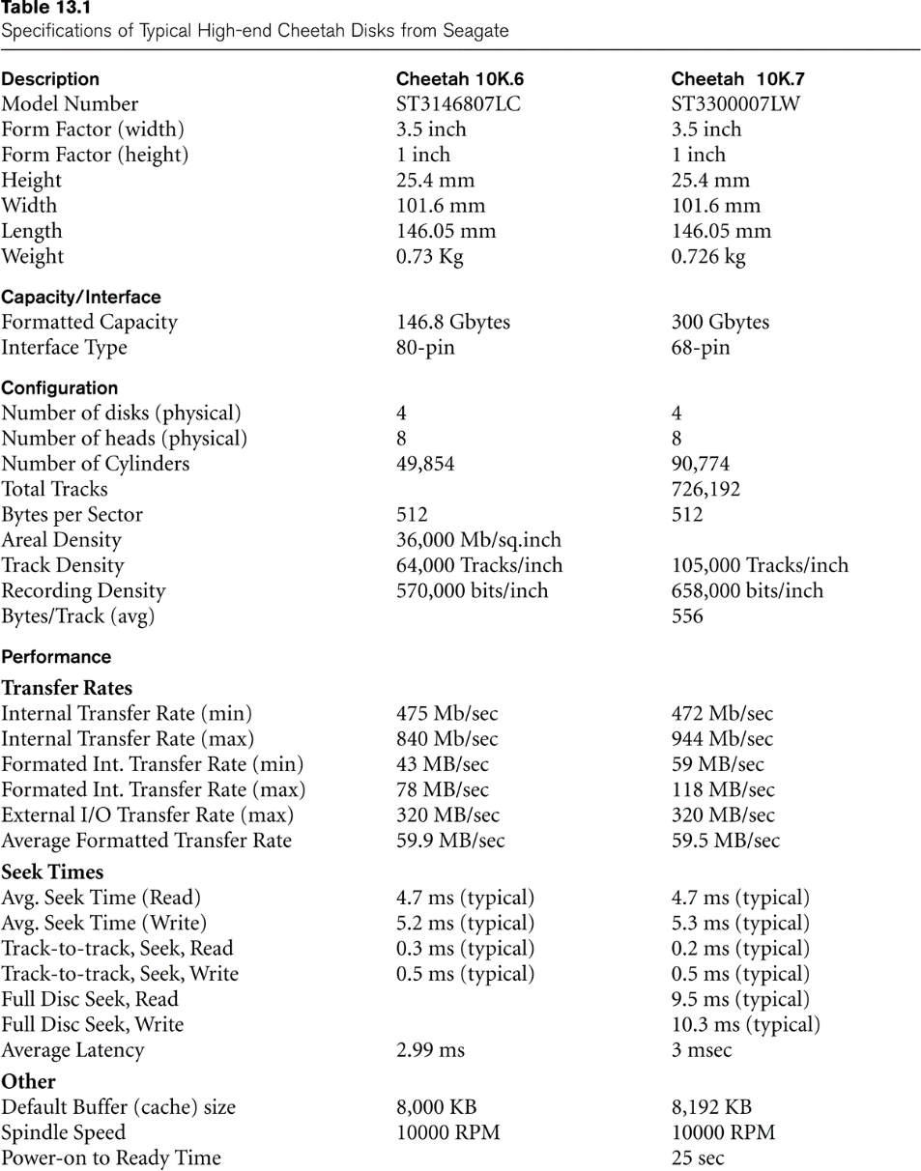
Typical Disk Parameters
(Courtesy of Seagate Technology)
Slide 13- <number>

Slide 11
Records
Fixed and variable length records
Records contain fields which have values of a particular type
  E.g., amount, date, time, age
Record type – collection of field names and their data types
data type – type of values a field can take
Integer - 4 bytes, long integer - 8 bytes, real number 4 bytes, Boolean 1 byte, date 10 bytes, fixed-length string of k characters k bytes.
Fields themselves may be fixed length or variable length
Variable length fields can be mixed into one record:
  Separator characters or length fields are needed so that the record can be “parsed.”
Slide 13- <number>

Slide 12
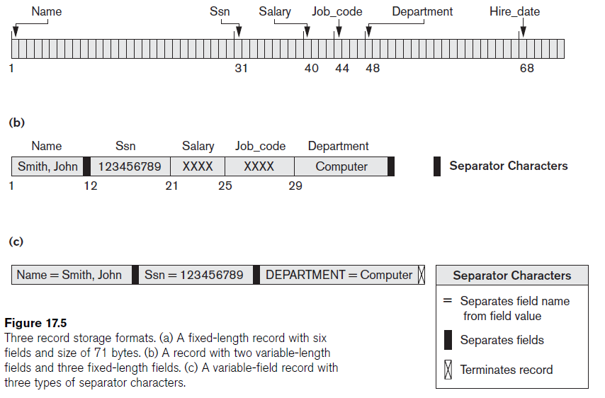
Records (continued)
Slide 13- <number>

Slide 13

Blocking
Blocking:
  Refers to storing a number of records in one block on the disk.
Blocking factor (bfr) refers to the number of records per block.
There may be empty space in a block if an integral number of records do not fit in one block.
Spanned Records:
  Refers to records that exceed the size of one or more blocks and hence span a number of blocks.
Number of blocks for a file of r records -
Slide 13- <number>

Slide 14
Files of Records
A file is a sequence of records, where each record is a collection of data values (or data items).
A file descriptor (or file header) includes information that describes the file, such as the field names and their data types, and the addresses of the file blocks on disk.
Records are stored on disk blocks.
The blocking factor bfr for a file is the (average) number of file records stored in a disk block.
A file can have fixed-length records or variable-length records.
Slide 13- <number>

Slide 15
Files of Records (contd.)
File records can be unspanned or spanned
  Unspanned: no record can span two blocks
  Spanned: a record can be stored in more than one block
The physical disk blocks that are allocated to hold the records of a file can be contiguous, linked, or indexed.
In a file of fixed-length records, all records have the same format.
  Usually, unspanned blocking is used with such files.
Files of variable-length records require additional information to be stored in each record, such as separator characters and field types.
  Usually spanned blocking is used with such files.
Slide 13- <number>

Slide 16
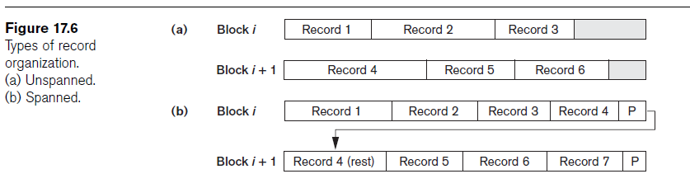
Files of Records (contd.)
Slide 13- <number>

Slide 17
Operation on Files
Typical file operations include: (Retrieval and update)
  OPEN: Prepares file for reading/writing. Allocates appropriate buffers to hold file blocks from disk, and retrieves the file header. Sets the file pointer to the beginning of the file (current file record)
  FIND: Searches for the first file record that satisfies a certain condition, and makes it the current file record.
  FINDNEXT: Searches for the next file record (from the current record) that satisfies a certain condition, and makes it the current file record.
  READ: Reads the current file record from buffer into a program variable.
  INSERT: Inserts a new record into the file & makes it the current file record.
  DELETE: Removes the current file record from the file, usually by marking the record to indicate that it is no longer valid.
  MODIFY: Changes the values of some fields of the current file record.
  CLOSE: Terminates access to the file.
  REORGANIZE: Reorganizes the file records.
    For example, the records marked deleted are physically removed from the file or a new organization of the file records is created.
  READ_ORDERED: Read the file blocks in order of a specific field of the file.

Slide 18
Files of unordered records – Unordered File
Also called a heap or a pile file.
New records are inserted at the end of the file.
A linear search through the file records is necessary to search for a record.
  This requires reading and searching half the file blocks on the average, and is hence quite expensive.
Record insertion is quite efficient.
Reading the records in order of a particular field requires sorting the file records.
Slide 13- <number>

Slide 19
Files of Ordered Records - Ordered Files
Also called a sequential file.
File records are kept sorted by the values of an ordering field.
  Reading extremely efficient,
  Finding next record – no extra block access
Insertion is expensive: records must be inserted in the correct order.
  One way – keep some record space in every block.
  Alternatively - It is common to keep a separate unordered overflow (or transaction) file for new records to improve insertion efficiency; this is periodically merged with the main ordered file. Searching becomes complex.
A binary search can be used to search for a record on its ordering field value.
  This requires reading and searching log₂ of the file blocks on the average, an improvement over linear search.
Reading the records in order of the ordering field is quite efficient.
Modifying a field – ordering key field/nonordering field
Slide 13- <number>

Slide 20
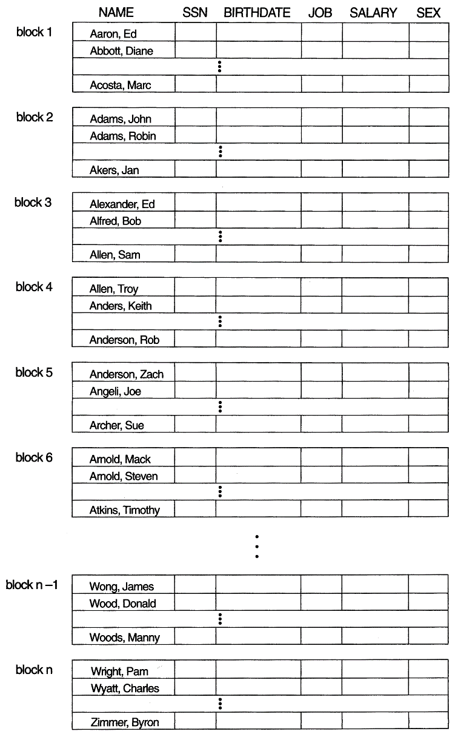
Ordered Files (contd.)
Slide 13- <number>

Slide 21
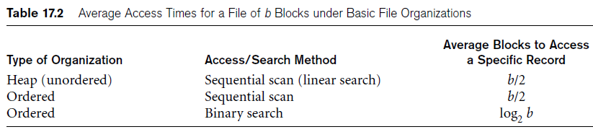
Average Access Times
The following table shows the average access time to access a specific record for a given type of file
Slide 13- <number>

Slide 22
Hashed Files
Hashing for disk files is called External Hashing
The file blocks are divided into M equal-sized buckets, numbered bucket₀, bucket₁, ..., bucket_{M-1}.
  Typically, a bucket corresponds to one (or a fixed number of) disk block.
One of the file fields is designated to be the hash key of the file.
The record with hash key value K is stored in bucket i, where i=h(K), and h is the hashing function.
Search is very efficient on the hash key – single block access.
Collisions occur when a new record hashes to a bucket that is already full.
  An overflow file is kept for storing such records.
  Overflow records that hash to each bucket can be linked together.
Slide 13- <number>

Slide 23
Hashed Files (contd.)
There are numerous methods for collision resolution, including the following:
  Open addressing: Proceeding from the occupied position specified by the hash address, the program checks the subsequent positions in order until an unused (empty) position is found.
  Chaining: For this method, various overflow locations are kept, usually by extending the array with a number of overflow positions. In addition, a pointer field is added to each record location. A collision is resolved by placing the new record in an unused overflow location and setting the pointer of the occupied hash address location to the address of that overflow location.
  Multiple hashing: The program applies a second hash function if the first results in a collision. If another collision results, the program uses open addressing or applies a third hash function and then uses open addressing if necessary.
Slide 13- <number>

Slide 24
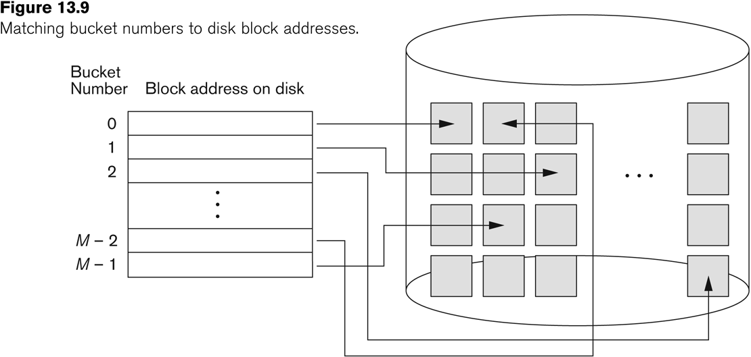
Hashed Files (contd.)

Slide 25
Hashed Files (contd.)
To reduce overflow records, a hash file is typically kept 70-80% full.
The hash function h should distribute the records uniformly among the buckets
  Otherwise, search time will be increased because many overflow records will exist.
Main disadvantages of static external hashing:
  Fixed number of buckets M is a problem if the number of records in the file grows or shrinks.
  Ordered access on the hash key is quite inefficient (requires sorting the records).
Slide 13- <number>

Slide 26
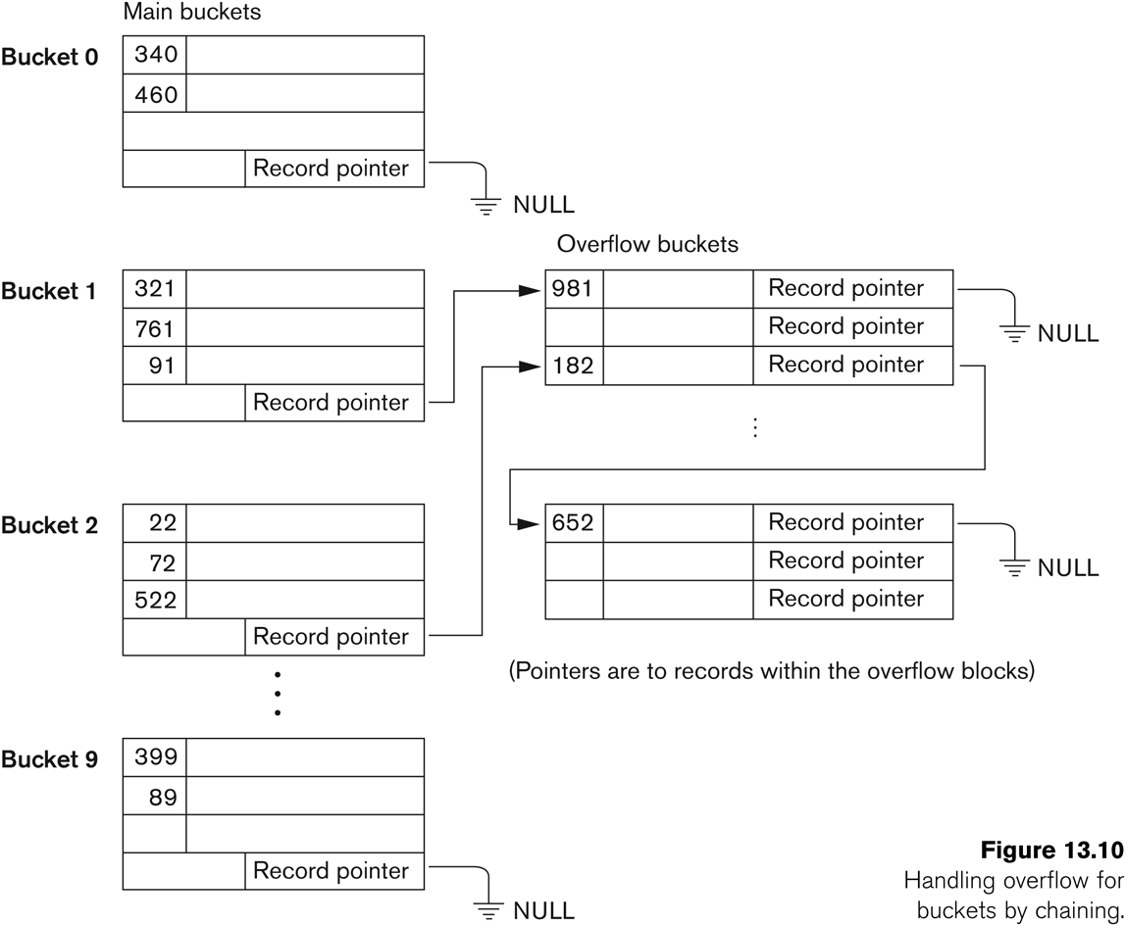
Hashed Files - Overflow handling

Slide 27
Dynamic And Extendible Hashed Files
Dynamic and Extendible Hashing Techniques
  Hashing techniques to allow the dynamic growth and shrinking of the number of file records.
  techniques - dynamic hashing, extendible hashing, and linear hashing.
    Extendible hashing - access structure based on the values that result after application of the hash function to the search field. In indexing, the access structure is based on the values of the search field itself.
    linear hashing - does not require additional access structures.
    dynamic hashing - uses an access structure based on binary tree data structures
  Both dynamic and extendible hashing use the binary representation of the hash value h(K) in order to access a directory.
  In dynamic hashing the directory is a binary tree.
  In extendible hashing the directory is an array of size 2^{d} where d is called the global depth.
Slide 13- <number>

Slide 28
Dynamic And Extendible Hashing (contd.)
The directories can be stored on disk, and they expand or shrink dynamically.
  Directory entries point to the disk blocks that contain the stored records.
An insertion in a disk block that is full causes the block to split into two blocks and the records are redistributed among the two blocks.
  The directory is updated appropriately.
Dynamic and extendible hashing do not require an overflow area.
Linear hashing does require an overflow area but does not use a directory.
  Blocks are split in linear order as the file expands.
Slide 13- <number>

Slide 29
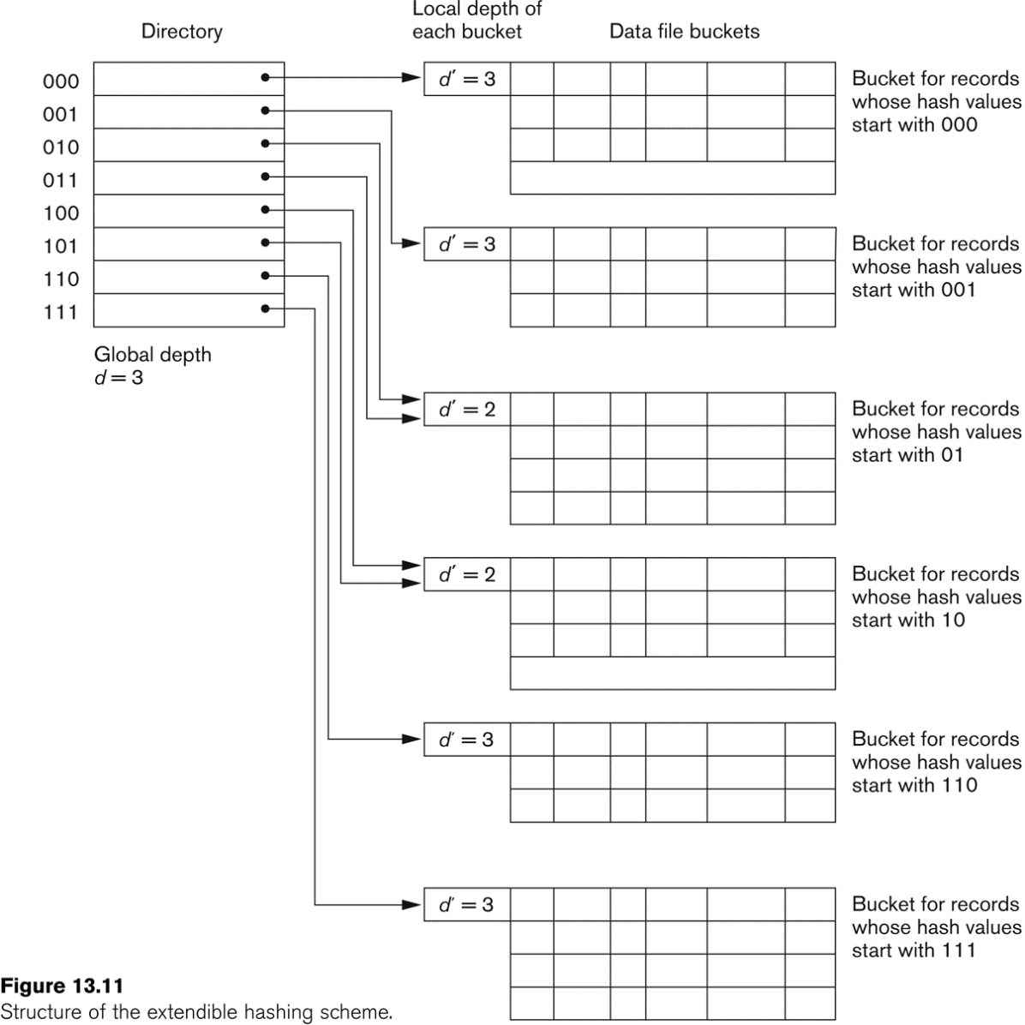
Extendible Hashing
Slide 13- <number>

Slide 30
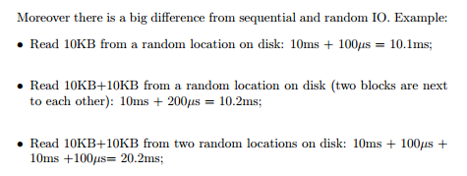
Slide 13- <number>

Slide 31
Parallelizing Disk Access using RAID Technology.
Secondary storage technology must take steps to keep up in performance and reliability with processor technology.
A major advance in secondary storage technology is represented by the development of RAID, which originally stood for Redundant Arrays of Inexpensive Disks.
The main goal of RAID is to even out the widely different rates of performance improvement of disks against those in memory and microprocessors.
Slide 13- <number>

Slide 32
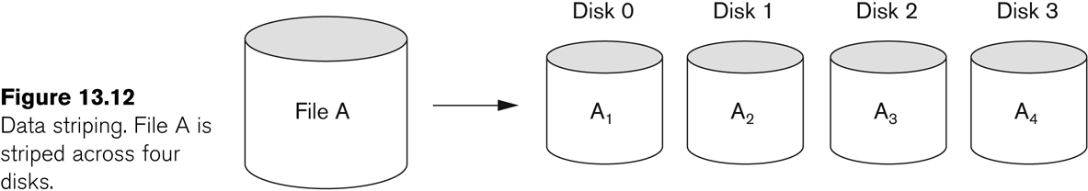
RAID Technology (contd.)
A natural solution is a large array of small independent disks acting as a single higher-performance logical disk.
A concept called data striping is used, which utilizes parallelism to improve disk performance.
Data striping distributes data transparently over multiple disks to make them appear as a single large, fast disk.
Slide 13- <number>

Slide 33
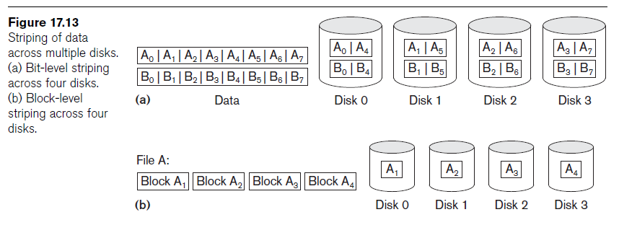
RAID Technology (contd.)
Slide 13- <number>

Slide 34
RAID Technology (contd.)
Different raid organizations were defined based on different combinations of the two factors of granularity of data interleaving (striping) and pattern used to compute redundant information.
  Raid level 0 – has no redundant data (best write performance) at the risk of data loss, uses data striping
  Raid level 1 uses mirrored disks.
  Raid level 2 uses memory-style redundancy by using Hamming codes, which contain parity bits for distinct overlapping subsets of components. Level 2 includes both error detection and correction.
  Raid level 3 uses a single parity disk relying on the disk controller to figure out which disk has failed.
  Raid Levels 4 and 5 use block-level data striping, with level 5 distributing data and parity information across all disks.
  Raid level 6 applies the so-called P + Q redundancy scheme using Reed-Soloman codes to protect against up to two disk failures by using just two redundant disks.
Slide 13- <number>

Slide 35
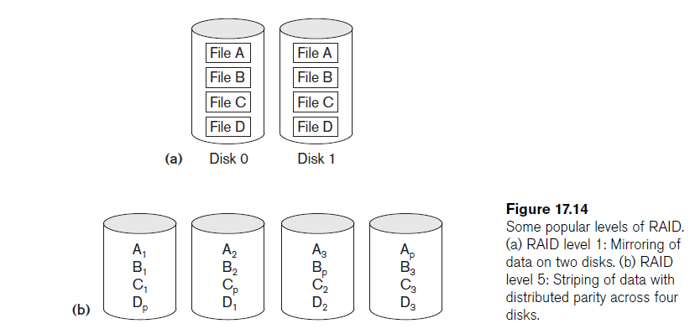
RAID Technology (contd.)
Slide 13- <number>

Slide 36
Use of RAID Technology (contd.)
Different raid organizations are being used under different situations
  Raid level 1 (mirrored disks) is the easiest for rebuild of a disk from other disks
    It is used for critical applications like logs
  Raid level 2 uses memory-style redundancy by using Hamming codes, which contain parity bits for distinct overlapping subsets of components.
    Level 2 includes both error detection and correction.
  Raid level 3 (single parity disks relying on the disk controller to figure out which disk has failed) and level 5 (block-level data striping) are preferred for Large volume storage, with level 3 giving higher transfer rates.
Most popular uses of the RAID technology currently are:
  Level 0 (with striping), Level 1 (with mirroring) and Level 5 with an extra drive for parity.
Design Decisions for RAID include:
  Level of RAID, number of disks, choice of parity schemes, and grouping of disks for block-level striping.
Slide 13- <number>

Slide 37
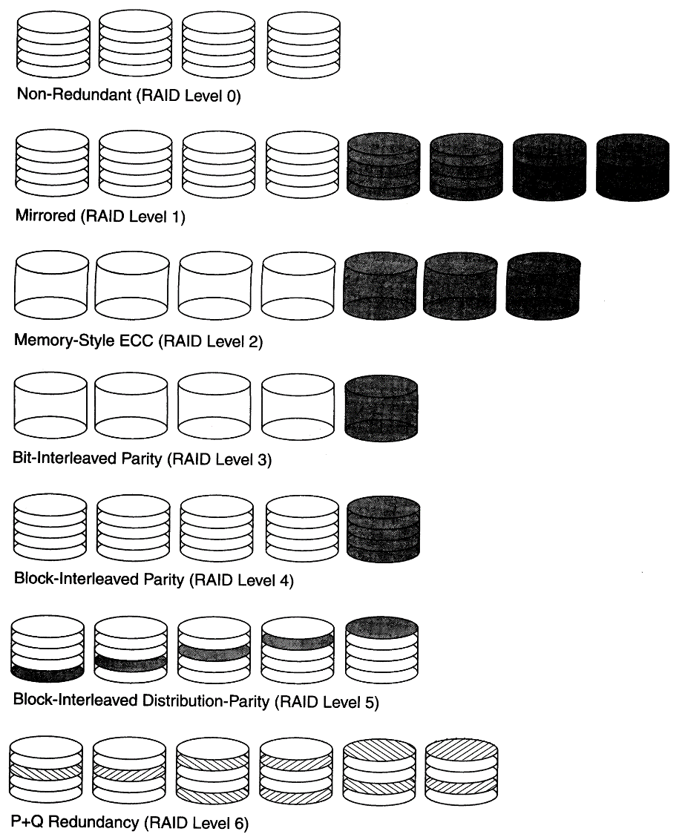
Use of RAID Technology (contd.)
Slide 13- <number>

Slide 38
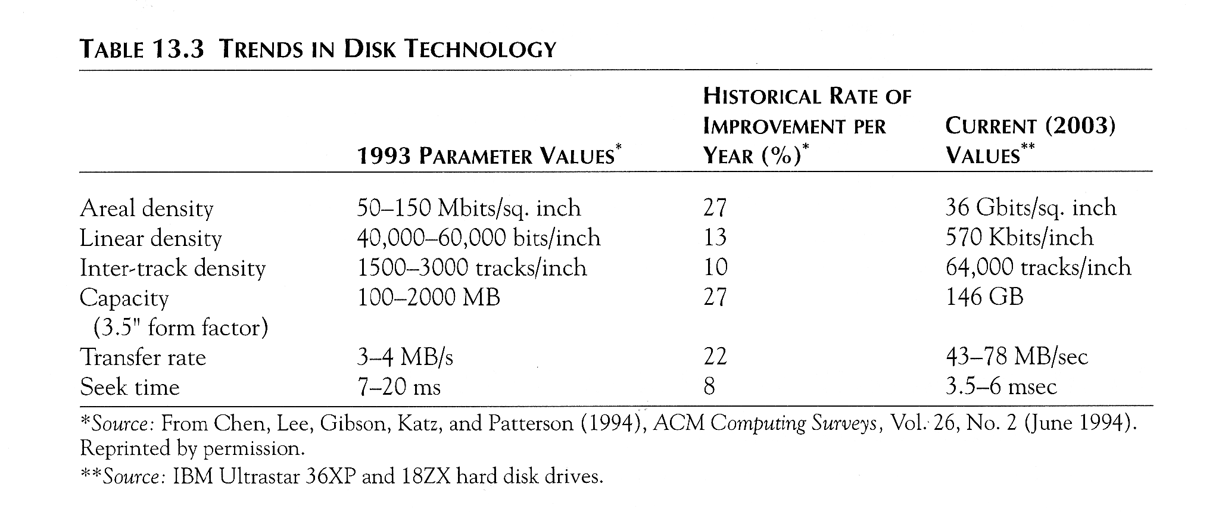
Trends in Disk Technology
Slide 13- <number>

Slide 39
Storage Area Networks
The demand for higher storage has risen considerably in recent times.
Organizations have a need to move from a static fixed data center oriented operation to a more flexible and dynamic infrastructure for information processing.
Thus they are moving to a concept of Storage Area Networks (SANs).
  In a SAN, online storage peripherals are configured as nodes on a high-speed network and can be attached and detached from servers in a very flexible manner.
This allows storage systems to be placed at longer distances from the servers and provide different performance and connectivity options.
Slide 13- <number>

Slide 40
Storage Area Networks (contd.)
Advantages of SANs are:
  Flexible many-to-many connectivity among servers and storage devices using fiber channel hubs and switches.
  Up to 10km separation between a server and a storage system using appropriate fiber optic cables.
  Better isolation capabilities allowing non-disruptive addition of new peripherals and servers.
SANs face the problem of combining storage options from multiple vendors and dealing with evolving standards of storage management software and hardware.
Slide 13- <number>

Slide 41
Summary
Disk Storage Devices
Files of Records
Operations on Files
Unordered Files
Ordered Files
Hashed Files
  Dynamic and Extendible Hashing Techniques
RAID Technology
Slide 13- <number>

